Slide 1

332:479 Concepts in VLSI
Design
Lecture 23
Circuit Pitfalls and Reliability
David Harris and Mike Bushnell
Harvey Mudd College and Rutgers University
Spring 2004

Slide 2
Material from: Principles of CMOS VLSI Design
By Neil E. Weste and Kamran Eshraghian

Slide 3
Outline
Circuit Pitfalls
  Detective puzzle
  Given circuit and symptom, diagnose cause and recommend solution
  All these pitfalls have caused failures in real chips
Noise Budgets
Reliability
  Latchup
  Latchup Prevention
Yield
Summary

Slide 4
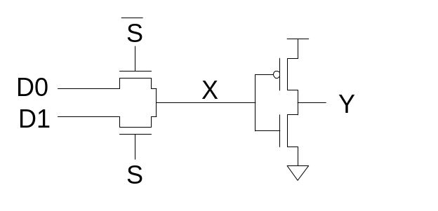
Bad Circuit 1
Circuit
  2:1 multiplexer
Symptom
  Mux works when selected D is 0 but not 1.
  Or fails at low V_{DD}.
  Or fails in SFSF corner.
Principle:
Solution:

Slide 5
Bad Circuit 1
Circuit
  2:1 multiplexer
Symptom
  Mux works when selected D is 0 but not 1.
  Or fails at low V_{DD}.
  Or fails in SFSF corner.
Principle: Threshold drop
  X never rises above V_{DD}-V_{t}
  V_{t} is raised by the body effect
  The threshold drop is most serious as V_{t} becomes a greater fraction of V_{DD}.
Solution:

Slide 6
Bad Circuit 1
Circuit
  2:1 multiplexer
Symptom
  Mux works when selected D is 0 but not 1.
  Or fails at low V_{DD}.
  Or fails in SFSF corner.
Principle: Threshold drop
  X never rises above V_{DD}-V_{t}
  V_{t} is raised by the body effect
  The threshold drop is most serious as V_{t} becomes a greater fraction of V_{DD}.
Solution: Use transmission gates, not pass transistors

Slide 7
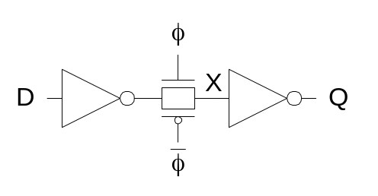
Bad Circuit 2
Circuit
  Latch
Symptom
  Load a 0 into Q
  Set φ = 0
  Eventually Q spontaneously flips to 1
Principle:
Solution:

Slide 8
Bad Circuit 2
Circuit
  Latch
Symptom
  Load a 0 into Q
  Set φ = 0
  Eventually Q spontaneously flips to 1
Principle: Leakage
  X is a dynamic node holding value as charge on the node
  Eventually subthreshold leakage may disturb charge
Solution:

Slide 9
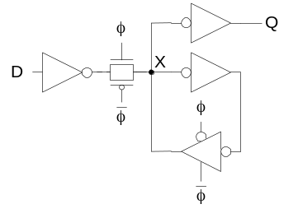
Bad Circuit 2
Circuit
  Latch
Symptom
  Load a 0 into Q
  Set φ = 0
  Eventually Q spontaneously flips to 1
Principle: Leakage
  X is a dynamic node holding value as charge on the node
  Eventually subthreshold leakage may disturb charge
Solution: Staticize node with feedback
  Or periodically refresh node (requires fast clock,
  not practical processes with big leakage)

Slide 10
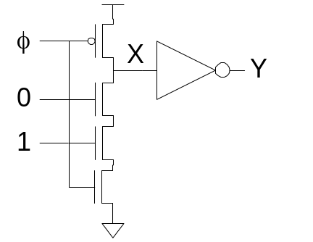
Bad Circuit 3
Circuit
  Domino AND gate
Symptom
  Precharge gate (Y=0)
  Then evaluate
  Eventually Y spontaneously flips to 1
Principle:
Solution:

Slide 11
Bad Circuit 3
Circuit
  Domino AND gate
Symptom
  Precharge gate (Y=0)
  Then evaluate
  Eventually Y spontaneously flips to 1
Principle: Leakage
  X is a dynamic node holding value as charge on the node
  Eventually subthreshold leakage may disturb charge
Solution:

Slide 12
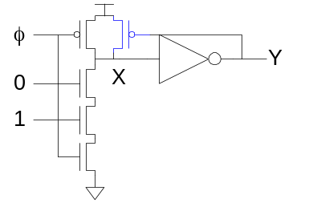
Bad Circuit 3
Circuit
  Domino AND gate
Symptom
  Precharge gate (Y=0)
  Then evaluate
  Eventually Y spontaneously flips to 1
Principle: Leakage
  X is a dynamic node holding value as charge on the node
  Eventually subthreshold leakage may disturb charge
Solution: Keeper

Slide 13
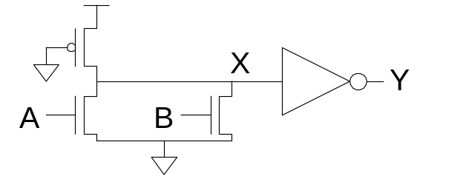
Bad Circuit 4
Circuit
  Pseudo-nMOS OR
Symptom
  When only one input is true, Y = 0.
  Perhaps only happens in SF corner.
Principle:
Solution:

Slide 14
Bad Circuit 4
Circuit
  Pseudo-nMOS OR
Symptom
  When only one input is true, Y = 0.
  Perhaps only happens in SF corner.
Principle: Ratio Failure
  nMOS and pMOS fight each other.
  If the pMOS is too strong, nMOS cannot pull X low enough.
Solution:

Slide 15
Bad Circuit 4
Circuit
  Pseudo-nMOS OR
Symptom
  When only one input is true, Y = 0.
  Perhaps only happens in SF corner.
Principle: Ratio Failure
  nMOS and pMOS fight each other.
  If the pMOS is too strong, nMOS cannot pull X low enough.
Solution: Check that ratio is satisfied in all corners

Slide 16
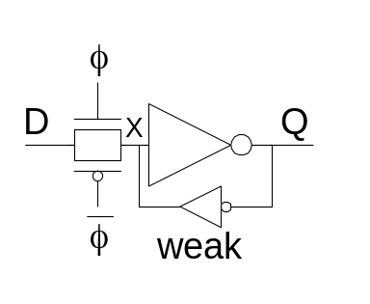
Bad Circuit 5
Circuit
  Latch
Symptom
  Q stuck at 1.
  May only happen for certain latches where input is driven by a small gate located far away.
Principle:
Solutions:

Slide 17
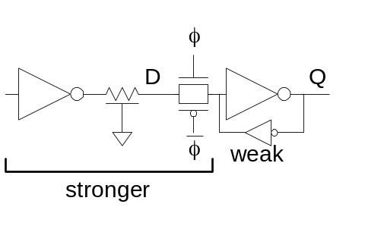
Bad Circuit 5
Circuit
  Latch
Symptom
  Q stuck at 1.
  May only happen for certain latches where input is driven by a small gate located far away.
Principle: Ratio Failure (again)
  Series resistance of D driver, wire
  resistance, and tgate must be much
  less than weak feedback inverter.
Solutions:

Slide 18
Bad Circuit 5
Circuit
  Latch
Symptom
  Q stuck at 1.
  May only happen for certain latches where input is driven by a small gate located far away.
Principle: Ratio Failure (again)
  Series resistance of D driver, wire
  resistance, and tgate must be much
  less than weak feedback inverter.
Solutions: Check relative strengths
  Avoid unbuffered diffusion inputs where driver is unknown

Slide 19
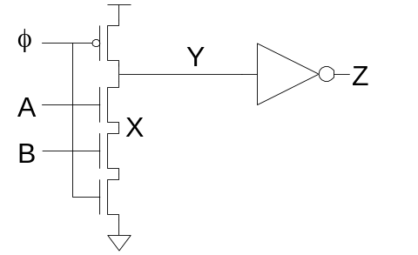
Bad Circuit 6
Circuit
  Domino AND gate
Symptom
  Precharge gate while
  A = B = 0, so Z = 0
  Set φ = 1
  A rises
  Z is observed to sometimes rise
Principle:
Solutions:

Slide 20
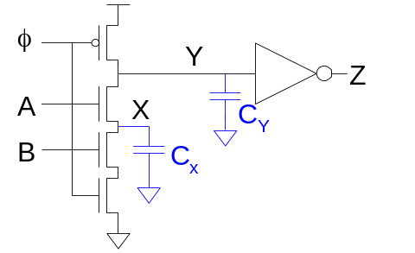
Bad Circuit 6
Circuit
  Domino AND gate
Symptom
  Precharge gate while
  A = B = 0, so Z = 0
  Set φ = 1
  A rises
  Z is observed to sometimes rise
Principle: Charge Sharing
  If X was low, it shares charge with Y
Solutions:

Slide 21
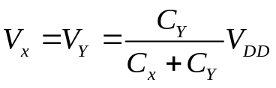
Bad Circuit 6
Circuit
  Domino AND gate
Symptom
  Precharge gate while
  A = B = 0, so Z = 0
  Set φ = 1
  A rises
  Z is observed to sometimes rise
Principle: Charge Sharing
  If X was low, it shares charge with Y
Solutions: Limit charge sharing
  Safe if C_{Y} >> C_{X}
  Or precharge node X too

Slide 22
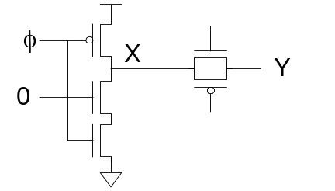
Bad Circuit 7
Circuit
  Dynamic gate + latch
Symptom
  Precharge gate while transmission gate latch is opaque
  Evaluate
  When latch becomes transparent, X falls
Principle:
Solution:

Slide 23
Bad Circuit 7
Circuit
  Dynamic gate + latch
Symptom
  Precharge gate while transmission gate latch is opaque
  Evaluate
  When latch becomes transparent, X falls
Principle: Charge Sharing
  If Y was low, it shares charge with X
Solution:

Slide 24
Bad Circuit 7
Circuit
  Dynamic gate + latch
Symptom
  Precharge gate while transmission gate latch is opaque
  Evaluate
  When latch becomes transparent, X falls
Principle: Charge Sharing
  If Y was low, it shares charge with X
Solution: Buffer dynamic nodes before
  driving transmission gate

Slide 25
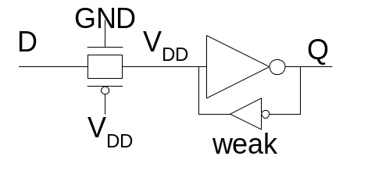
Bad Circuit 8
Circuit
  Latch
Symptom
  Q changes while latch is opaque
  Especially if D comes from a far-away driver
Principle:
Solution:

Slide 26
Bad Circuit 8
Circuit
  Latch
Symptom
  Q changes while latch is opaque
  Especially if D comes from a far-away driver
Principle: Diffusion Input Noise Sensitivity
  If D < -V_{t}, transmission gate turns on
  Most likely because of power supply noise or coupling on D
Solution:

Slide 27
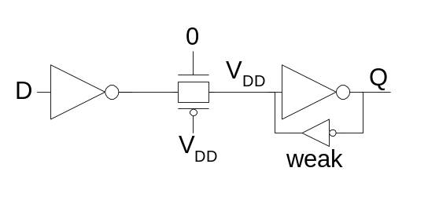
Bad Circuit 8
Circuit
  Latch
Symptom
  Q changes while latch is opaque
  Especially if D comes from a far-away driver
Principle: Diffusion Input Noise Sensitivity
  If D < -V_{t}, transmission gate turns on
  Most likely because of power supply noise or coupling on D
Solution: Buffer D locally

Slide 28
Bad Circuit 9
Circuit
  Anything
Symptom
  Some gates are slower than expected
Principle:

Slide 29
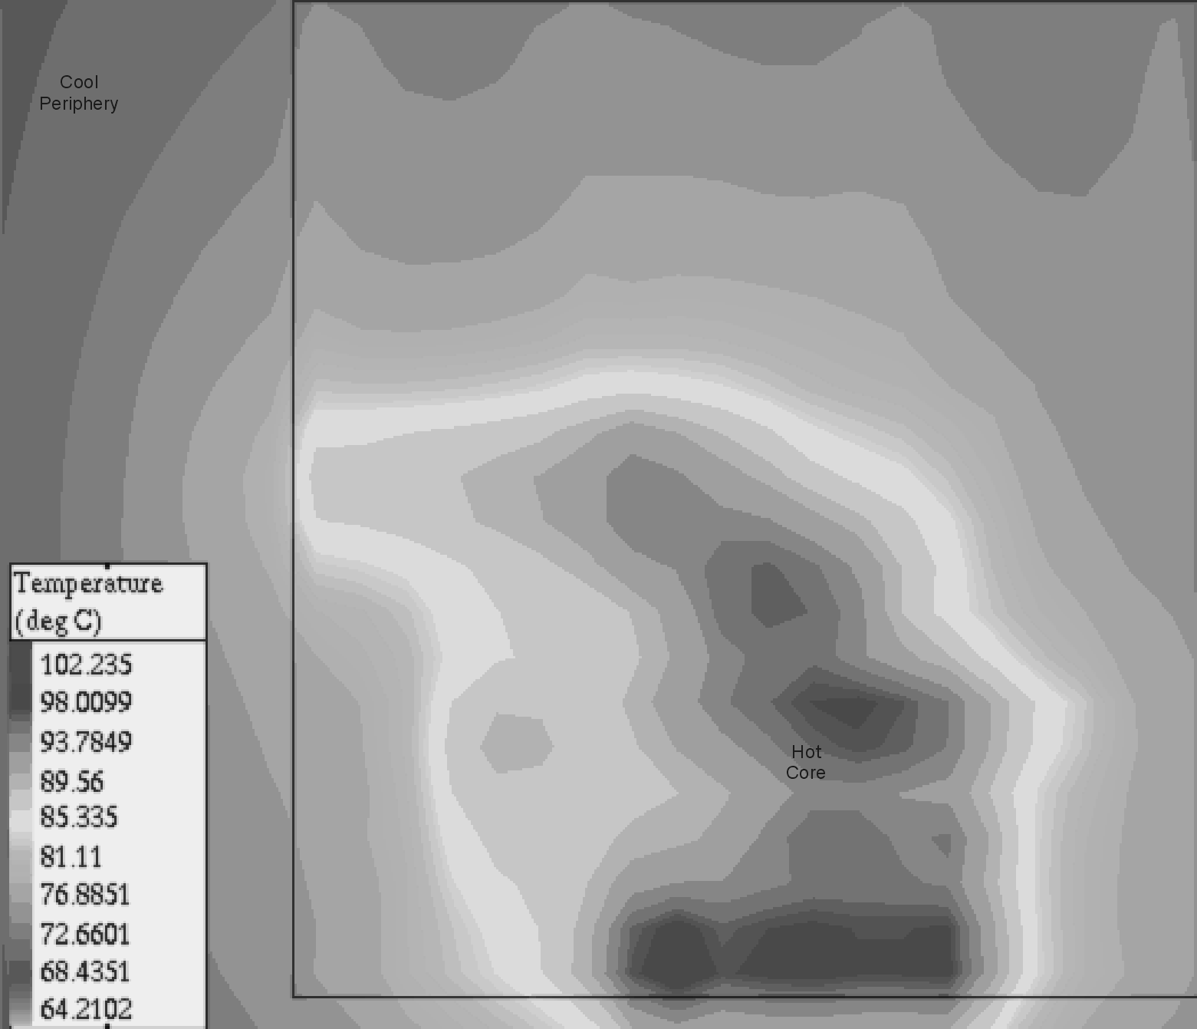
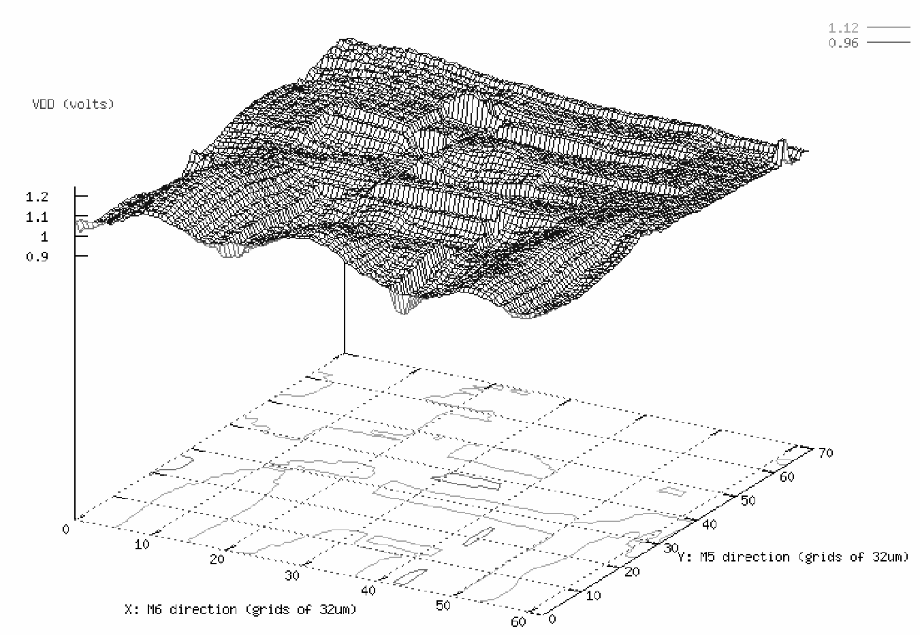
Bad Circuit 9
Circuit
  Anything
Symptom
  Some gates are slower than expected
Principle: Hot Spots and Power Supply Noise

Slide 30
Noise
Sources
  Power supply noise / ground bounce
  Capacitive coupling
  Charge sharing
  Leakage
  Noise feedthrough
Consequences
  Increased delay (for noise to settle out)
  Or incorrect computations

Slide 31
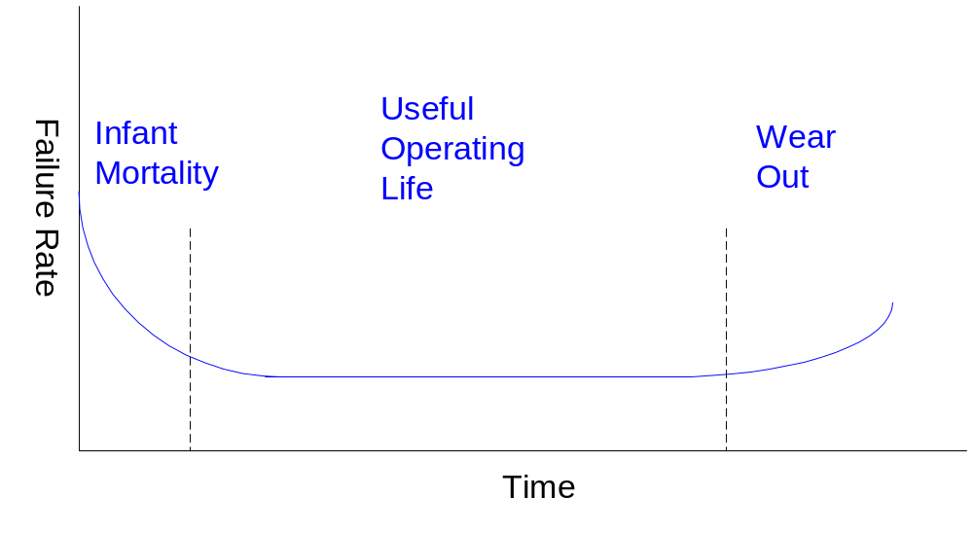
Reliability
Hard Errors
Soft Errors

Slide 32
Reliability
Main issues:
  Electromigration
  Self Heating
  Hot e– problems
  Oxide Failure
  Bipolar Transistor Degradation
  Package/Chip power dissipation
  Latchup
  Electro-Static Discharge (ESD) protection
Use accelerated life testing to simulate aging

Slide 33
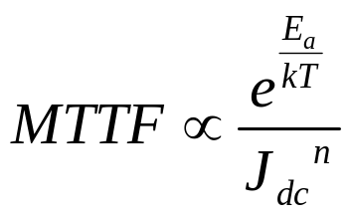
Electromigration
“Electron wind” causes movement of metal atoms along wires
Excessive electromigration leads to open circuits
Most significant for unidirectional (DC) current
  Depends on current density J_{dc} (current / area)
  Exponential dependence on temperature
  Black’s Equation:
  Typical limits: J_{dc} < 1 – 2 mA / μm²
See videos

Slide 34
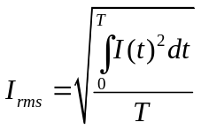
Self-Heating
Current through wire resistance generates heat
  Oxide surrounding wires is a thermal insulator
  Heat tends to build up in wires
  Hotter wires are more resistive, slower
Self-heating limits AC current densities for reliability
  Typical limits: J_{rms} < 15 mA / μm²

Slide 35
Hot Carriers
Electric fields across channel impart high energies to some carriers
  These “hot” carriers may be blasted into the gate oxide where they become trapped
  Accumulation of charge in oxide causes shift in V_{t} over time
  Eventually V_{t} shifts too far for devices to operate correctly
Choose V_{DD} to achieve reasonable product lifetime
  Worst problems for inverters and NORs with slow input risetime and long propagation delays

Slide 36
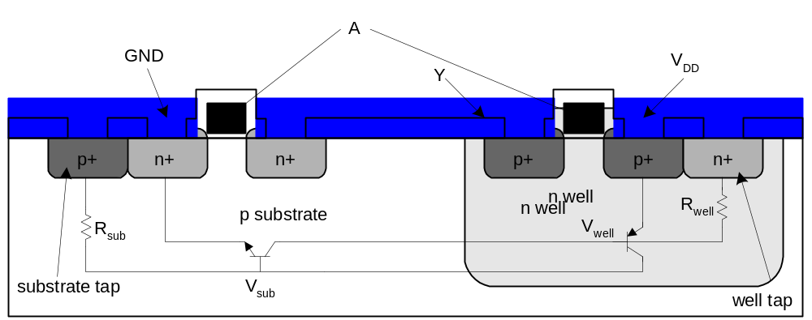
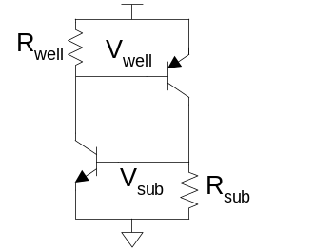
Latchup
Latchup: positive feedback leading to V_{DD} – GND short
  Major problem for 1970’s CMOS processes before
  it was well understood
Avoid by minimizing resistance of body to GND / V_{DD}
  Use plenty of substrate and well taps

Slide 37
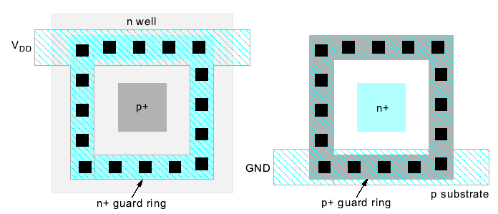
Guard Rings
Latchup risk greatest when diffusion-to-substrate diodes could become forward-biased
Surround sensitive region with guard ring to collect injected charge

Slide 38
Overvoltage
High voltages can damage transistors
  Electrostatic discharge
  Oxide arcing
  Punchthrough
  Time-dependent dielectric breakdown (TDDB)
    Accumulated wear from tunneling currents
Requires low V_{DD} for thin oxides and short channels
Use ESD protection structures where chip meets real world

Slide 39
Yield
Determines whether a semiconductor company makes money
  Technology
  Chip Area
  Layout
Y = # Good Chips on Wafer 100%
Total # Chips
Seed’s Model: Y = e (use for Y < 30%)
A = Chip Area
D = # lethal defects / cm² (defect density)
- AD

Slide 40
Yield
Murphy’s model: (Use for Y > 30% or for small chips)
Y = 1 – e
AD
Kooperberg’s recent model:
Y = Π 1 + Σ A_{j} D_{i} P_{ij}
i = 1 j c_{i}
[
-AD
]
2
N
(
)
-c_{i}

Slide 41
Yield
i = ith type of defect
j = jth module
P_{ij} = Probability that an i defect causes a fault in the jth module
c_{i} = density of ith type of defect
Yield decreases dramatically as area increases
Dry etch fab. Gives 1 D 5 defects / cm²
Improve memory yield with redundant rows & columns
Redundancy hard to do with random logic

Slide 42
Summary
Static CMOS gates are very robust
  Will settle to correct value if you wait long enough
Other circuits suffer from a variety of pitfalls
  Tradeoff between performance & robustness
Very important to check circuits for pitfalls
  For large chips, you need an automatic checker.
  Design rules aren’t worth the paper they are printed on unless you back them up with a tool.

Slide 43
Soft Errors
In 1970’s, DRAMs were observed to occasionally flip bits for no apparent reason
  Ultimately linked to alpha particles and cosmic rays
Collisions with particles create electron-hole pairs in substrate
  These carriers are collected on dynamic nodes, disturbing the voltage
Minimize soft errors by having plenty of charge on dynamic nodes
Tolerate errors through ECC, redundancy

